Slide 1
Hardware Sudoku Solver with AC-3 Constraint Propagation, MRV-Guided Backtracking, and VGA Display on Basys3 FPGA
Course Project of Digital System Design with FPGA (E3 231) on:
Team Members:
Karney Jayanath (SR No:26831 ) MTECH EPD
Madhumitha Ramaswamy (SR No: 26973) PhD
Course faculty: Prof. Debayan Das

Slide 2
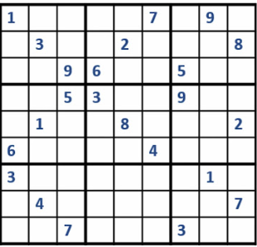
INTRODUCTION
Sudoku is a logic-based, combinatorial number-placement puzzle played on a grid, divided into nine sub grids. The goal is to fill the grid so every row, column, and box contains digits without repetition. It requires deductive reasoning, not mathematical calculation, to solve.
A Binary Constraint Satisfaction Problem (CSP) is a mathematical framework used to solve puzzles or scheduling issues where you need to find a valid state that satisfies a strict set of rules. Suduko is a well known BCSP
Motivation
Traditional Sudoku solvers based on pure backtracking explore a large exponential search space, making them inefficient for difficult puzzles.
Hard puzzles such as AI Escargot by Arto Inkala require deep search
Overall complexity becomes O(P + d^E), significantly lower than O(9^E), where d<9 Where E is the number of Empty cells, P is the number of AC3 passes

Slide 3
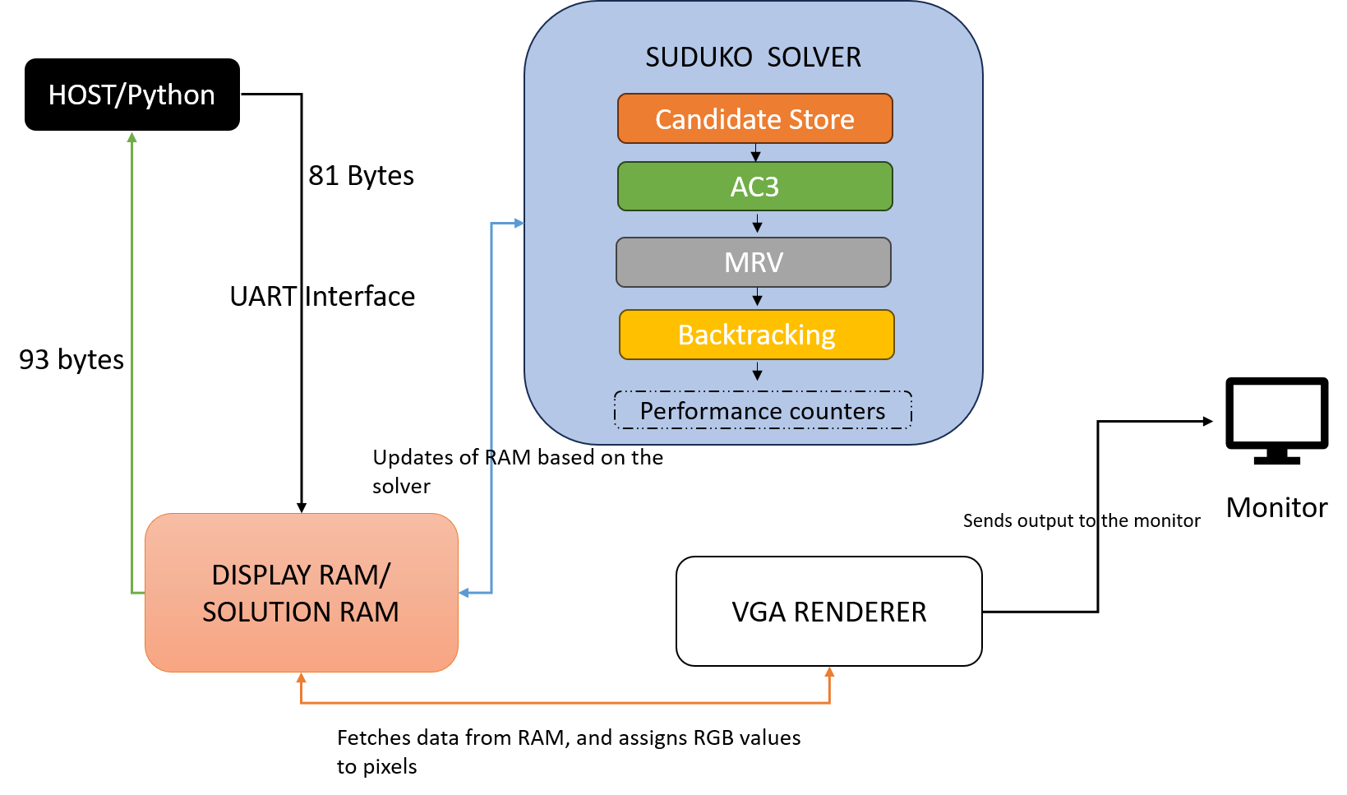
System Architecture
100Mhz Clock
UART communication between PC and FPGA
Sudoku Solver is the core
MEMORY ORGANISATION
Display RAM: display ram[0:80], 81 ×4 bits) holds the current sudoku grid, continuously read by the VGA
The solution RAM (solution ram[0:80], 81 × 4 bits) : holds the solution from the puzzle
Candidate store:maintains possible values for each cell using 9 bit mask

Slide 4
UART Interface
CLKS per bit : 868 (100,000,000/115,200 ≈ 868)
Baud rate 115200
The host Python script transmits exactly 81 bytes, each carrying a BCD digit (0 for empty, 1–9 for given clues) in the lower nibble. The FPGA echoes the solution as 81 bytes followed by 11 performance bytes and a sentinel 0xFE, for a total of 93 bytes per transaction.

Slide 5
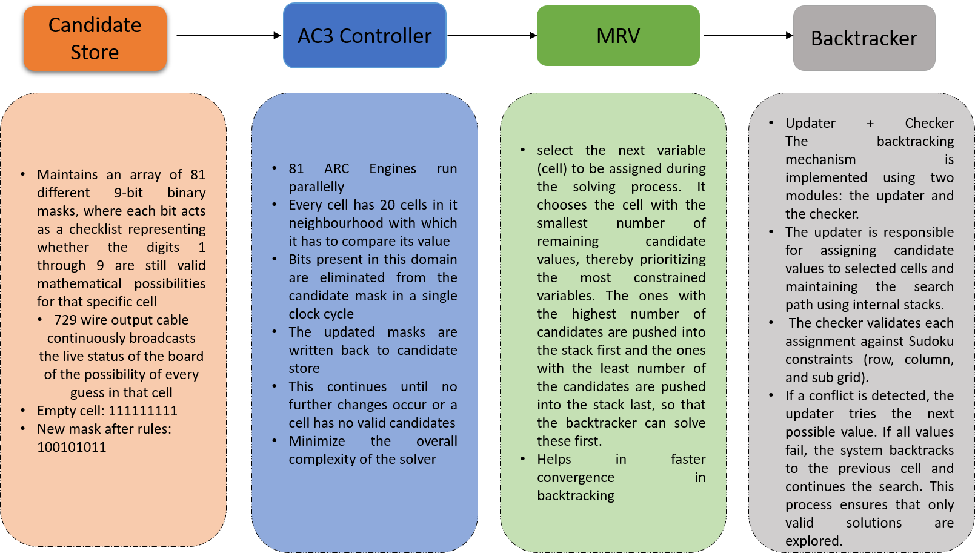
SOLVER ARCHITECTUE

Slide 6
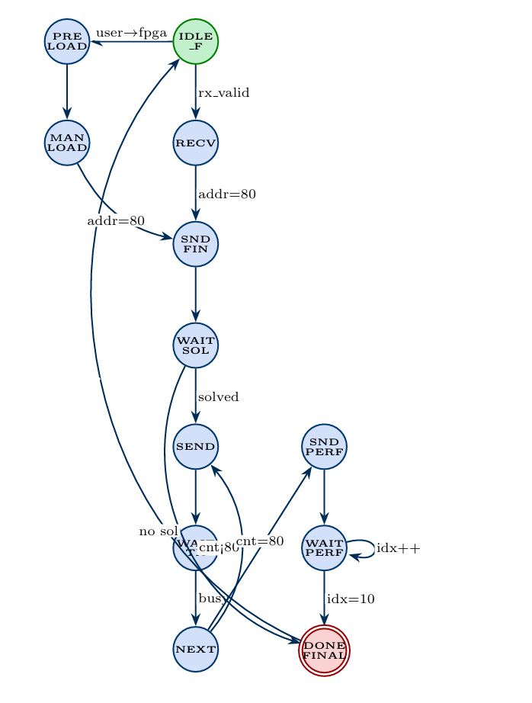
TOP LEVEL FSM
Once the FPGA receives the input puzzle either through UART or Manual Load and S15 is flicked down
start the AC-3
Wait for the solution
If solution exists, then success
Else Fail
Count bytes number of bytes transmitted(<80? SEND: SEND PERF)
SEND Performance Metrics

Slide 7
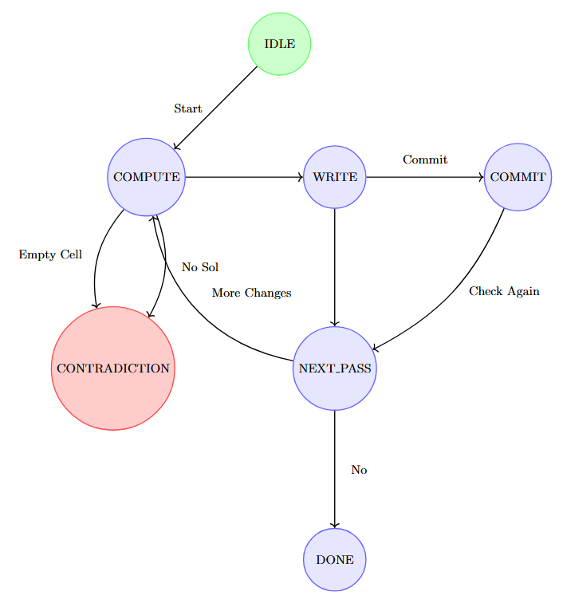
AC3 Controller FSM
Once the start signal is given, the state machine moves to the compute phase
Each of the 81 engines run in parallel checking for constraints, and compute new mask
The updated masks are then written back into the candidate store
COMMIT: Changes become visible
NEXT Pass: Check if more changes needed
If yes Compute again
If any cell has 0 candidates: Contradiction , no solution possible
When no more elimination exists, all cells are stable, DONE!

Slide 8
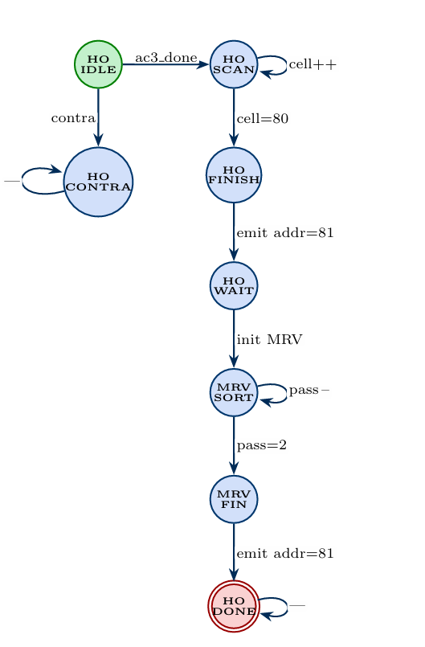
HAND-OFF FSM BETWEEN
AC3 AND BACKTRACKING
Wait for the AC3 controller result
If Ac3_contradicts result, then FAIL, sets out_answer=2’b01
HO_SCAN: iterates through all 81 cells and reads the mask, if only 1 bit is set, then passes the address and data, and fixes the singleton values, and marks the ac3_solved cell as 1. Once its in the 80th cell, goes to HO_FINISH
HO_Wait: set up for MRV SORT
MRV SORT: 2 loops, outer loop, mrv_pass counts from 9🡪2 , inner loop , variable ho_cell scans from 0-80, if the, and fore each cell finds the popcount, i.e. no of bits set in the mask, if popcount==mrv_pass, pushes the cell into the stack.
When all the MRV cells are sent, MRV_FINISH

Slide 9
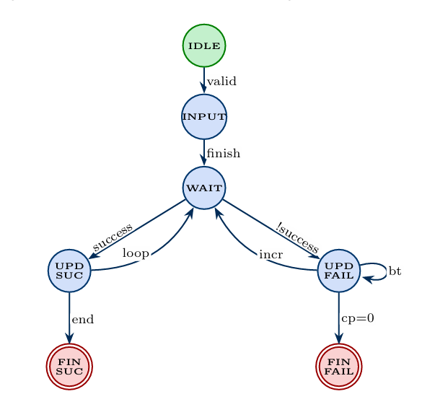
UPDATER FSM
IDLE: Wait for empty cells position of the MRV
INPUT: stores position of the unsolved cells from the AC3 Engine in the array shift_pos_r[], candidate masks for the corresponding cells are stored in the candidate store
WAIT: each of the possible guesses are sent to the checker, which checks if it’s a valid guess by comparing with 20 neighbouring cells
UPDATE_SUCCESS: guessed value is valid, in_success is 1, update the suduko grid, move to the next unsolved cell in shift_pos_r[], and then try with corresponding masks
UPDATE_FAILED: if the guessed value is failed then try with next possible candidate mask, if there are no possible candidates left for this mask, go to the previous cell and try with the other possible candidate mask which was not tried(BACKTRACKING). Failure of current cell means previous choice was wrong.

Slide 10
UI Interface and How to play the Game?
Menu has 4 tabs, FPGA MODE, USER MODE, STATS, RESET selectable using the directional buttons(all buttons are debounced with a 20 bit counter)
SWITCHES: S15 is flicked down, the solution to the question is visible in the screen
In USER MODE, the board is cleared, the user can input the numbers using switches 3:0, and flick S14 up, for loading the number onto the board
If any conflict occurs while loading the input, then the cells with conflict is highlighted in red
When a question is sent through python and we want the hint for that particular cell, then S13 can be flicked up

Slide 11
VGA
VGA Sync generator: Generates coordinates timing signals for 640 × 480 @ 60 Hz display
• Uses a 25 MHz pixel clock derived from 100 MHz system , each pixel is displayed every 40ns
Implemented as a 2-stage pipeline:
• Stage 1 computes geometry, memory lookup, and glyph decoding
• Stage 2 performs final RGB color selection
• Outputs RGB signals (vga_r, vga_g, vga_b) for display
• VGA sync generates pixel coordinates and synchronization signals, scanning the entire 640×480 screen
• VGA renderer uses these coordinates to determine the current cell and fetches data from display RAM / solution RAM
• Bitmap font (glyph ROM) is used to render digits within each cell
• Renderer assigns RGB values for each pixel and outputs signals to the monitor
The board alone is 432x432, each cell is 48x48
Each pixel has 3 channels and 4 bits per channel(4096 combinations)

Slide 12
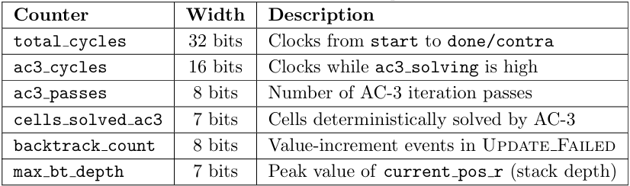
Performance Counters/Stats tab

Slide 13
DESIGN PRINCIPLES
Candidate-store bus width. The rd mask all bus is 81 × 9 = 729 bits wide. Routing 729 signals from the candidate-store registers to the AC-3 engine and handoff FSM in a single cycle would violate timing at 100MHz. The solution is to declare multicycle-path constraints (2-setup / 1-hold) for these paths, allowing the router two clock cycles to close timing while the logic consumes only one pipeline stage.
Board-flat bus. Similarly, the 81 ×4 = 324-bit board-flat bus from the display RAM to the VGA pipeline Stage-1 registers is declared as a multicycle path. Since pix en fires only every four clocks, four full 100MHz cycles are actually available between successive pixel activations, making the 2-cycle relaxation entirely conservative.
Two-stage VGA pipeline. The renderer separates pixel processing into two registered stages: Stage-1 evaluates all geometry (cell membership, cursor overlap, font glyph lookup, conflict state) in one clock; Stage-2 (colour select) reads only Stage-1 outputs. No single combinational path stretches from raw pixel coordinates to RGB output, keeping all paths within one clock period
A pipelined conflict detector that avoids integer division in index computation by replacing runtime arithmetic with registered lookup tables, enabling a 27-comparison full-board scan at 100MHz within a 30-cycle pipeline.

Slide 14
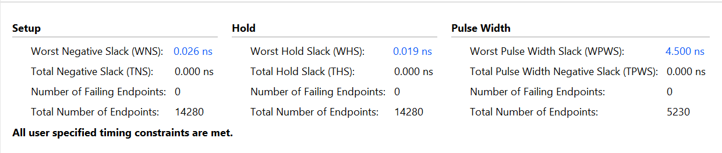
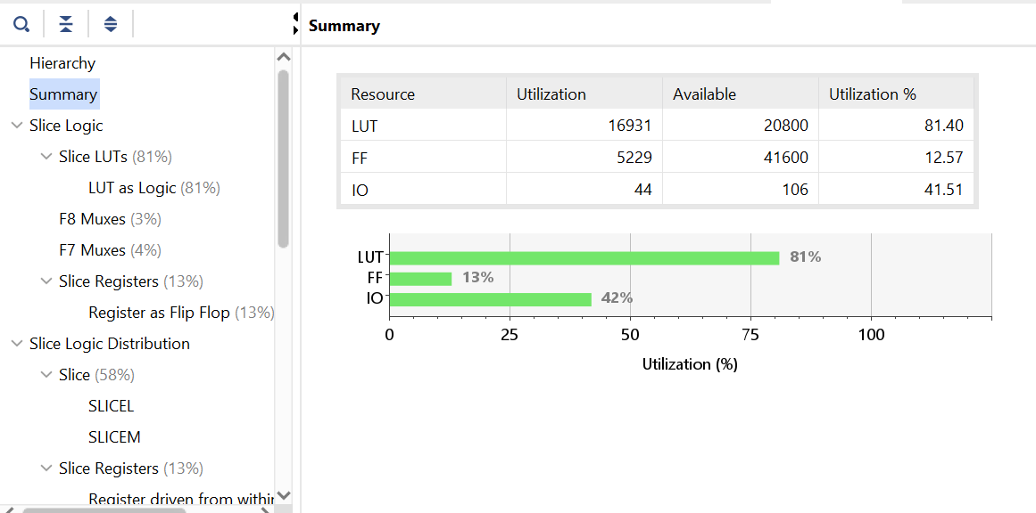
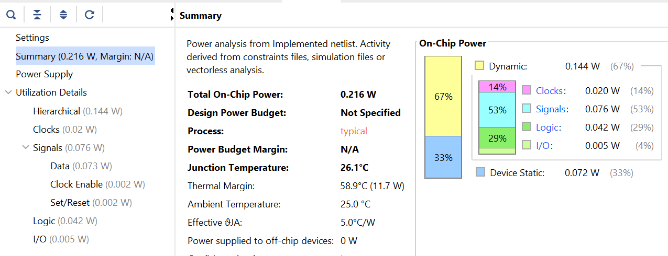
Timing, Power and Resource Utilization

Slide 15
THANK YOU

